Slide 1
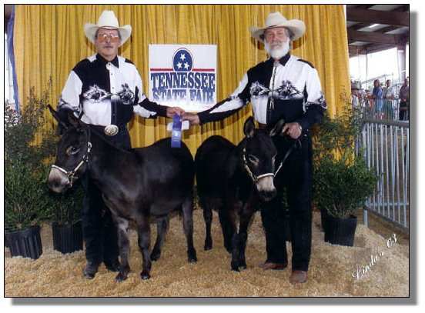
Two sample tests
Geog4300/6300
Jerry Shannon

Slide 2
Variablesc | Tests; test statistics; SE
Continuous; one sample: σ known and n > 30 OR data is a proportion | One-sample z-test; Z; SE = σ/sqrt(n); OR Diff. of proportions
Continuous; one sample: σ unknown or n < 30 | One-sample t-test; t; SE = s/sqrt(n-1)
Continuous; two samples | Student’s t-test for difference of means
Continuous; paired samples | Paired t-test
Continuous; more than two samples | ANOVA
Discrete; two variables; counts | Chi-square, goodness of fit
Continuous; two or more variables | Regression
You are here

Slide 3
Two sample tests
Comparing means of two samples
Does taking aspirin reduce the risk of heart attack?
Do women spend more time caring for children than men?
Does a bank prefer to lend to whites over blacks?

Slide 4
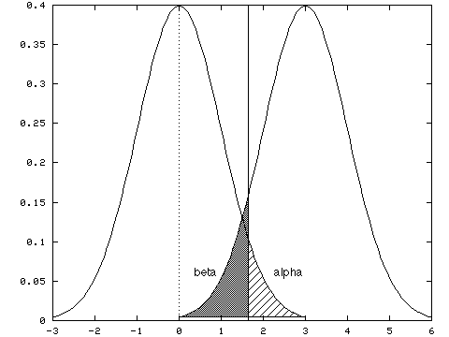
More complicated than a one sample test
More uncertainty with two samples: both mean and variance.
Key question: are the means of these groups significantly different given the variance in both groups?

Slide 5
An example
Is there a difference in the commute times in Charlotte versus Atlanta?
We have two population means:
One for Charlotte (μ₁)
One for Atlanta (μ₂)

Slide 6
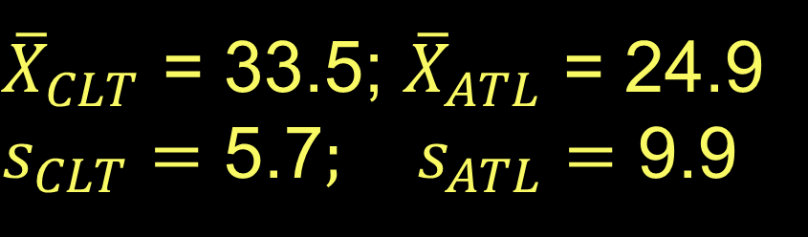
Is there a difference in the commute times in Charlotte versus Atlanta?
We asked 40 people in each city
${\overline{X}}_{CLT}$ = 33.5; ${\overline{X}}_{ATL}$ = 24.9
$s_{CLT}=\text{5}\text{.7}; s_{ATL}=$ 9.9
Difference in means is 8.6.
Is that significantly different?

Slide 7
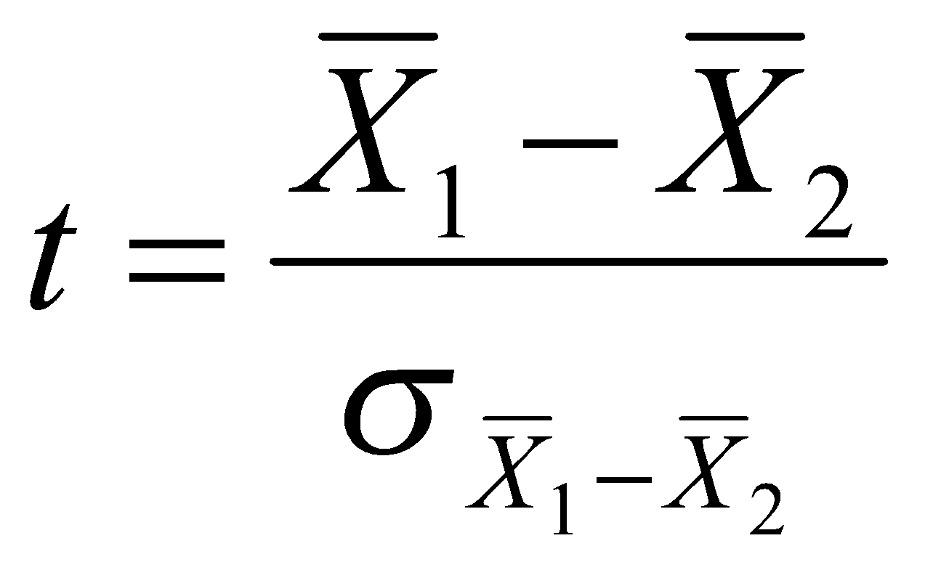
T test for difference of means
Requires three things:
Means
Standard deviation
Sample size
The difference in means
Standard error of the difference
The equation answers this question: is the difference between these means greater than the difference we’d expect from two samples of the same population?

Slide 8
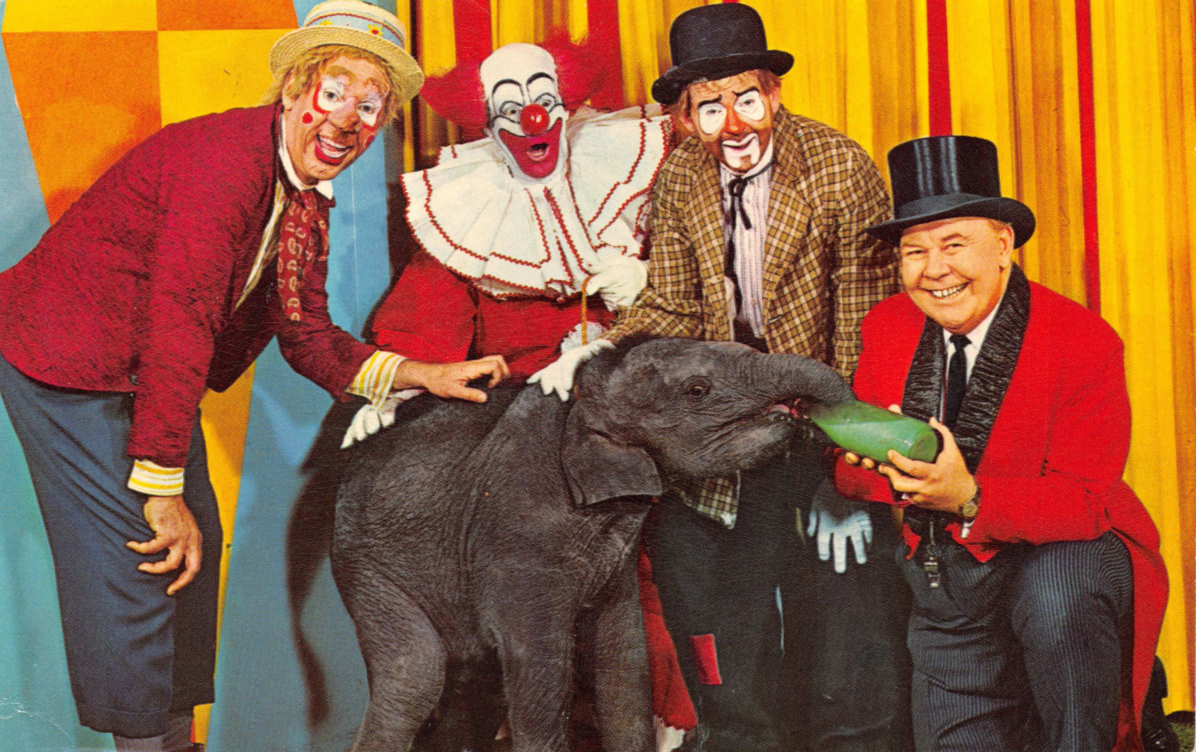
But wait, what’s the standard error of the difference?
That’s where the fun begins…

Slide 9
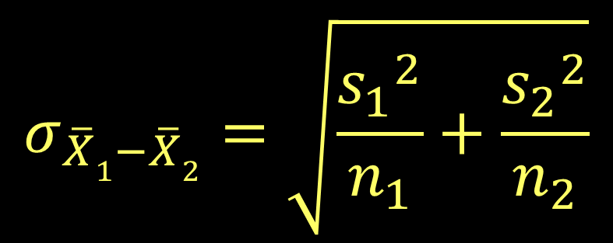
If your variances are unequal:
Create a separate variance estimate (SVE)
How do you know if your variances are unequal?
You can use an F test (var.test in R)
For this example, just use your best guess.

Slide 10
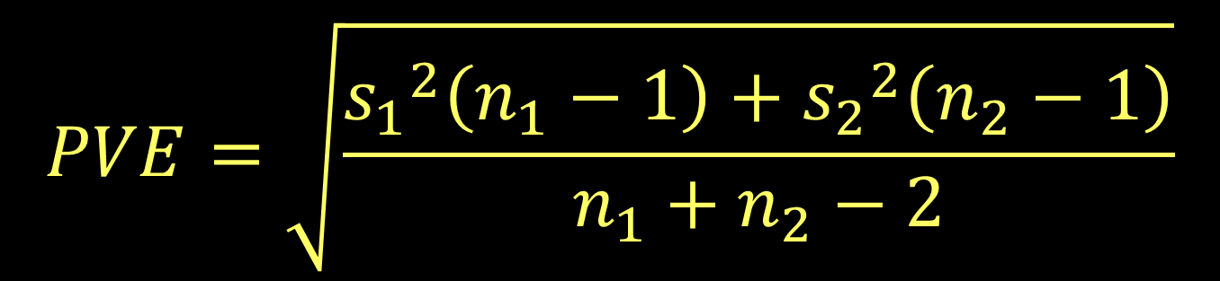
If your variances are equal:
You can increase your degrees of freedom
by creating a pooled variance estimate.
The PVE provides a single estimate of variance for both samples based on their respective standard deviations.

Slide 11
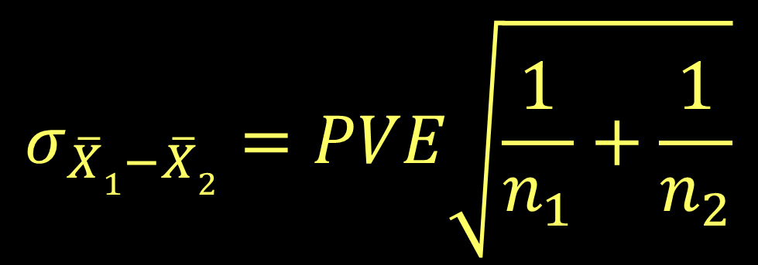
If your variances are equal:
The PVE is then used to calculate the standard error

Slide 12
What’s your degrees of freedom?
For unequal variances, it’s a complicated formula.
Usually you just let the computer figure it out.
Or you can approximate—choose the smaller of
n₁-1 or n₂-1
For equal variances, it’s simple:
n₁+n₂-2

Slide 13

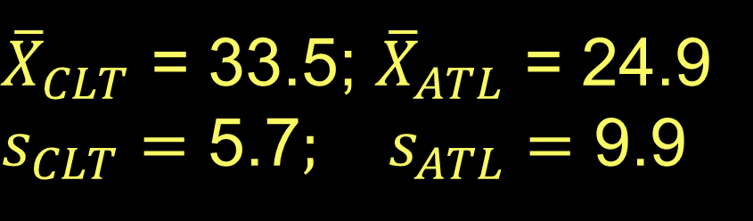

So what’s the answer?
Let’s assume unequal variances.
Remember that n=40 for both groups
What’s your null hypothesis?
$$H_{0}: μ_{CLT}= μ_{ATL}$$
What’s your alternate hypothesis?
$$H_{0}: μ_{CLT}≠ μ_{ATL}$$
${\overline{X}}_{CLT}$ = 33.5; ${\overline{X}}_{ATL}$ = 24.9
$s_{CLT}=\text{5}\text{.7}; s_{ATL}=$ 9.9

Slide 14
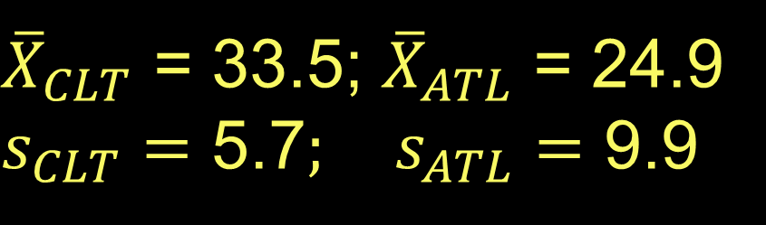
So what’s the answer?
Let’s assume unequal variances.
Remember that n=40 for both groups
What’s the test statistic for 95% confidence?
df = 39
t = 2.02, -2.02
${\overline{X}}_{CLT}$ = 33.5; ${\overline{X}}_{ATL}$ = 24.9
$s_{CLT}=\text{5}\text{.7}; s_{ATL}=$ 9.9

Slide 15
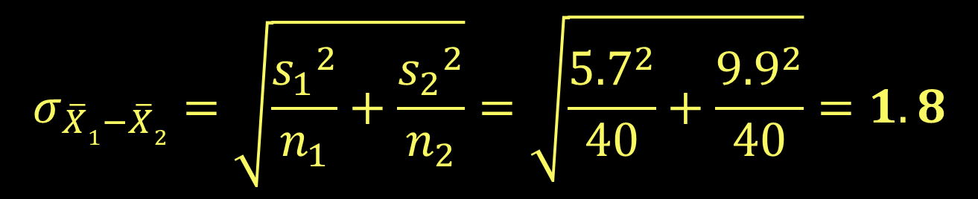
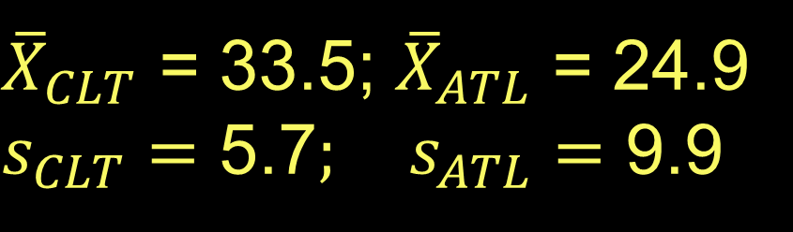
So what’s the answer?
Let’s assume unequal variances.
Remember that n=40 for both groups
Standard variance estimate:
$$σ_{\overline{X}1−\overline{X}2}=\sqrt{\frac{{s_{1}}^{2}}{n_{1}}+\frac{{s_{2}}^{2}}{n_{2}}}=\sqrt{\frac{{5.7}^{2}}{40}+\frac{{9.9}^{2}}{40}}=1.8$$
${\overline{X}}_{CLT}$ = 33.5; ${\overline{X}}_{ATL}$ = 24.9
$s_{CLT}=\text{5}\text{.7}; s_{ATL}=$ 9.9

Slide 16

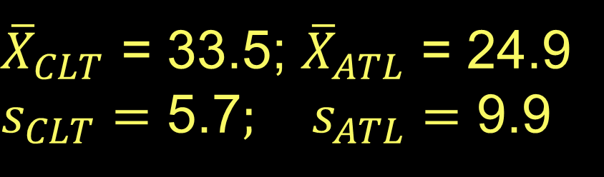
So what’s the answer?
Let’s assume unequal variances.
Remember that n=50 for both groups
$$t=\frac{{\overline{X}}_{1}−{\overline{X}}_{2} }{σ_{\overline{X}1−\overline{X}2}}=\frac{33.5−24.9}{1.8}=4.77$$
Can we reject the null hypothesis?
Yes!
${\overline{X}}_{CLT}$ = 33.5; ${\overline{X}}_{ATL}$ = 24.9
$s_{CLT}=\text{5}\text{.7}; s_{ATL}=$ 9.9

Slide 17
What if the variance is considered equal?
Null and alternative hypotheses remain the same.
Degrees of freedom go up:
40 + 40 – 2 = 78
The t value for 95% confidence is 1.99 or -1.99.
${\overline{X}}_{CLT}$ = 33.5; ${\overline{X}}_{ATL}$ = 24.9
$s_{CLT}=\text{5}\text{.7}; s_{ATL}=$ 9.9

Slide 18
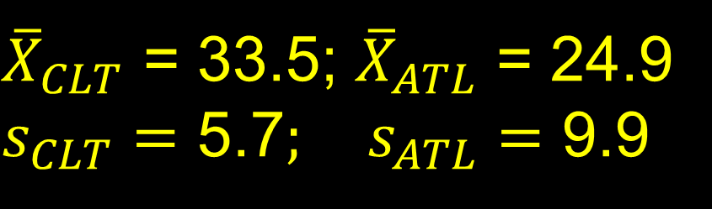
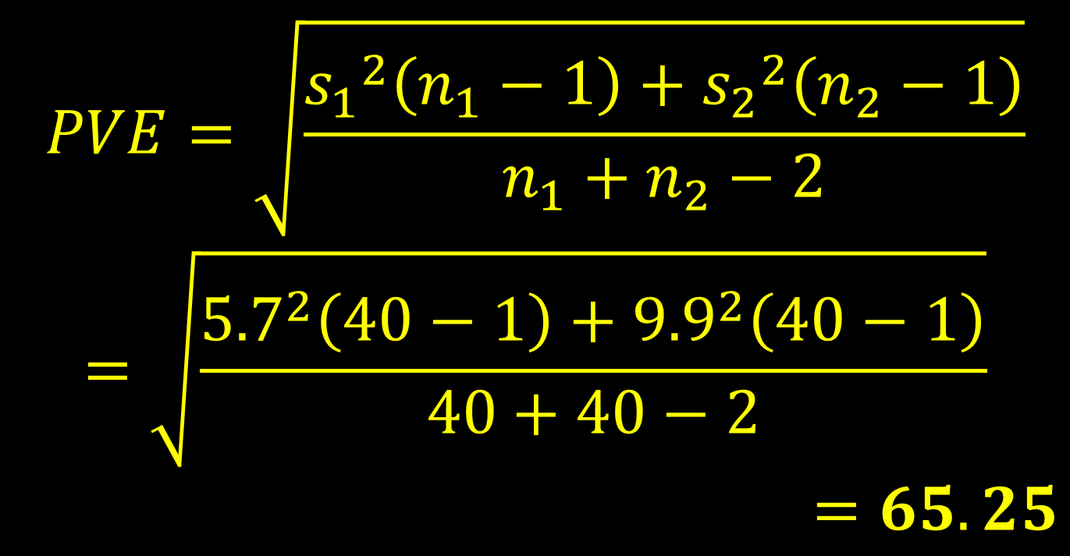
What if the variance is considered equal?
$$PVE=\sqrt{\frac{{s_{1}}^{2}\left(n_{1}−1\right)+{s_{2}}^{2}\left(n_{2}−1\right)}{n_{1}+n_{2}−2}}$$
$$=\sqrt{\frac{{5.7}^{2}\left(40−1\right)+{9.9}^{2}\left(40−1\right)}{40+40−2}}$$
$$=65.25$$
${\overline{X}}_{CLT}$ = 33.5; ${\overline{X}}_{ATL}$ = 24.9
$s_{CLT}=\text{5}\text{.7}; s_{ATL}=$ 9.9

Slide 19
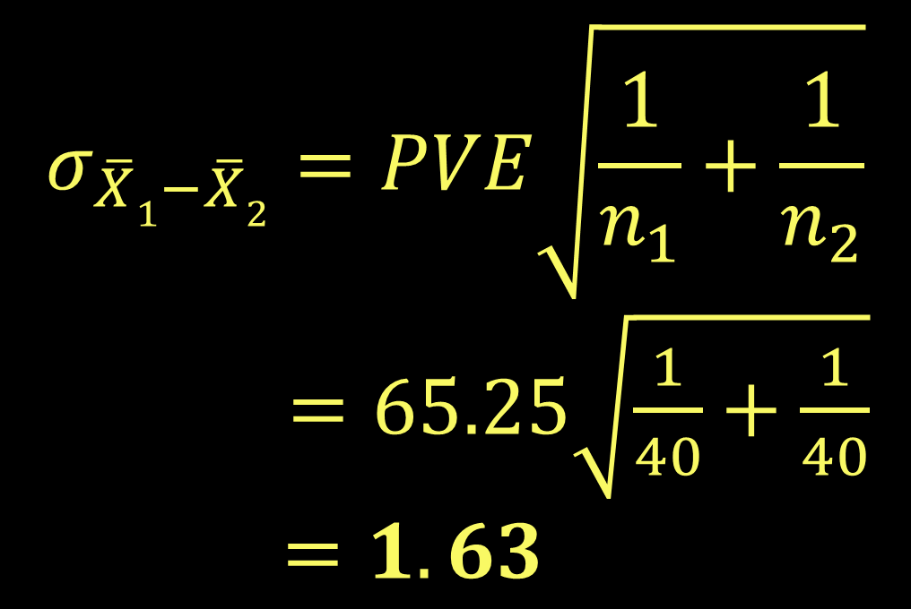
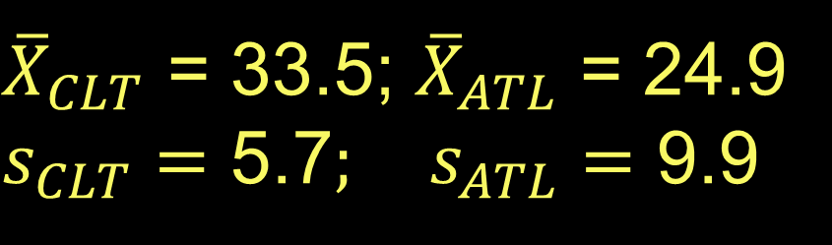
What if the variance is considered equal?
$$σ_{\overline{X}1−\overline{X}2}=PVE\sqrt{\frac{1}{n_{1}}+\frac{1}{n_{2}}}$$
$=65.25\sqrt{\frac{1}{40}+\frac{1}{40}}$
$=1.63$
${\overline{X}}_{CLT}$ = 33.5; ${\overline{X}}_{ATL}$ = 24.9
$s_{CLT}=\text{5}\text{.7}; s_{ATL}=$ 9.9

Slide 20

What if the variance is considered equal?
$$t=\frac{{\overline{X}}_{1}−{\overline{X}}_{2} }{σ_{\overline{X}1−\overline{X}2}}=\frac{33.5−24.9}{1.63}=5.27$$
In this case, the null hypothesis is STILL rejected.
Unequal variances: t = 4.77
Equal variances: t = 5.27

Slide 21

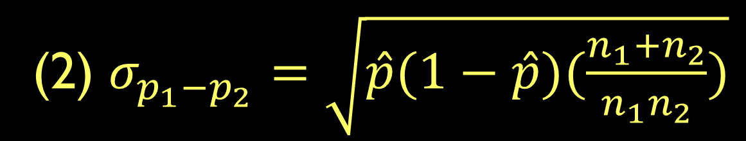
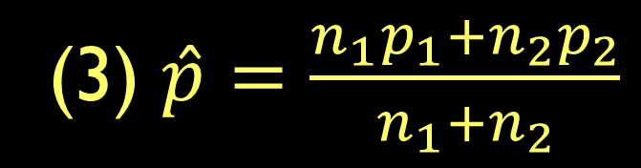
You can also test difference of proportions
Three equations are needed:
In a recent survey, 63% of Georgia students (n=64) said they drank coffee everyday. 71% of GA Tech students said the same (n=76). Are these numbers different?

Slide 22
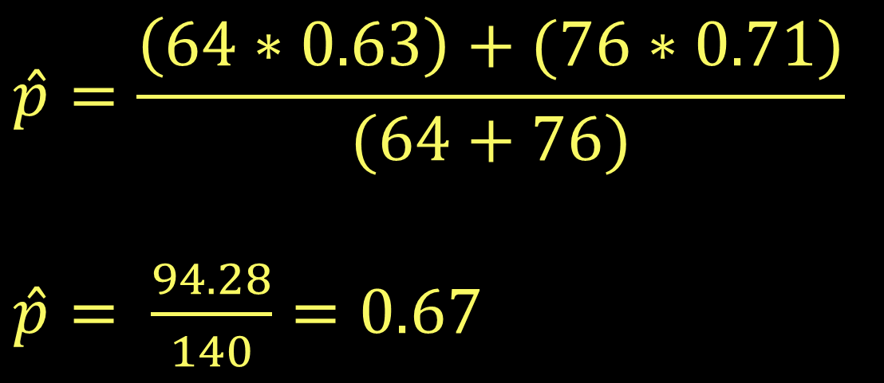
In a recent survey, 63% of Georgia students (n=64) said they drank coffee everyday. 71% of GA Tech students said the same (n=76). Are these numbers different?
$$\hat{p}=\frac{\left(64∗0.63\right)+(76∗0.71)}{(64+76)}$$
$\hat{p}= \frac{94.28}{140}=0.67$

Slide 23
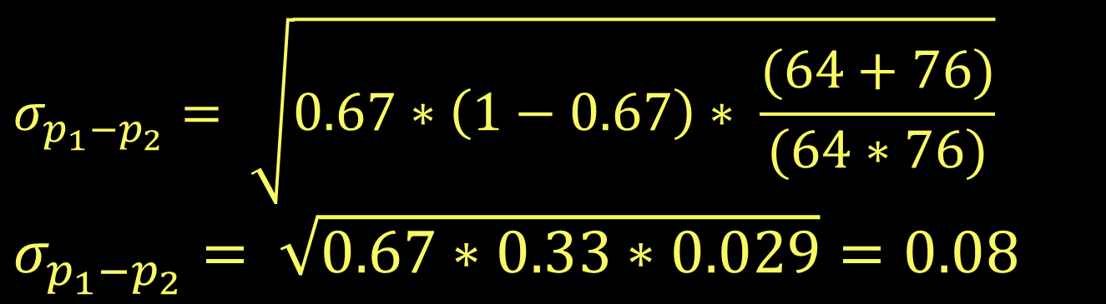
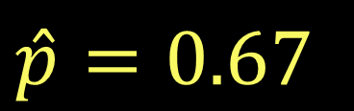
In a recent survey, 63% of Georgia students (n=64) said they drank coffee everyday. 71% of GA Tech students said the same (n=76). Are these numbers different?
$$σ_{p_{1}−p_{2}}= \sqrt{0.67∗\left(1−0.67\right)∗ \frac{(64+76)}{(64∗76)}}$$
$$σ_{p_{1}−p_{2}}= \sqrt{0.67∗0.33∗0.029}=0.08$$
$\hat{p}=0.67$

Slide 24

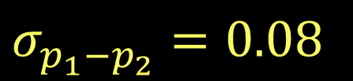
In a recent survey, 63% of Georgia students (n=64) said they drank coffee everyday. 71% of GA Tech students said the same (n=76). Are these numbers different?
$$Z_{p}= \frac{0.63 −0.71}{0.08}=−1$$
A Z score of -1 does not exceed the critical value of -1.96. We cannot reject the null hypothesis.
$$σ_{p_{1}−p_{2}}=0.08$$

Slide 25
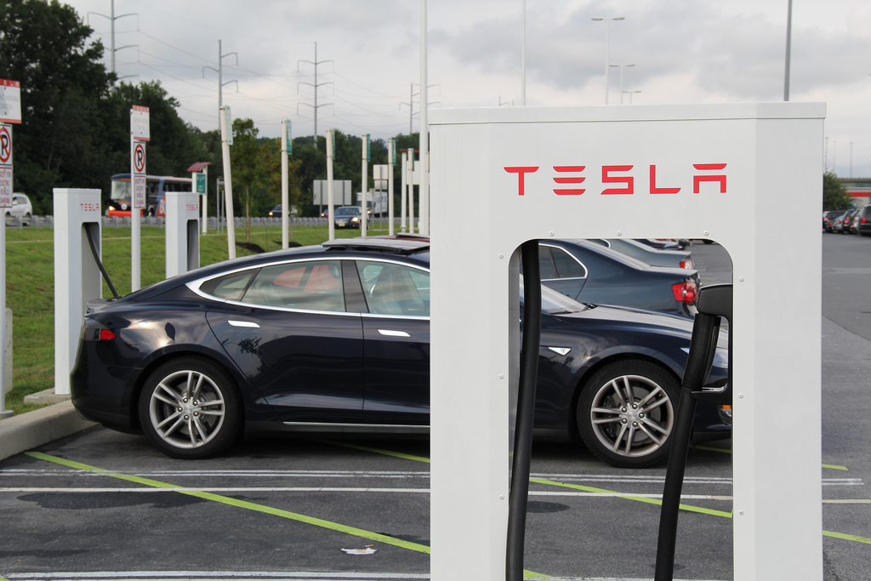
You try it:
You’re a research analyst for a research group studying fuel consumption. Assuming unequal variances, is there a difference in the average miles per gallon (mpg) of two car models (a = .05)? You collect the following:
 | Sedan | Van
Number of cars | 15 | 11
Mean mpg | 22.00 | 20.27
Std Dev | 4.77 | 4.64
Send Jerry the following (jshannon@uga.edu)
Your null and alternative hypotheses
The degrees of freedom and critical value for this test
Your test statistic and result (reject/accept null hypothesis)

Slide 26
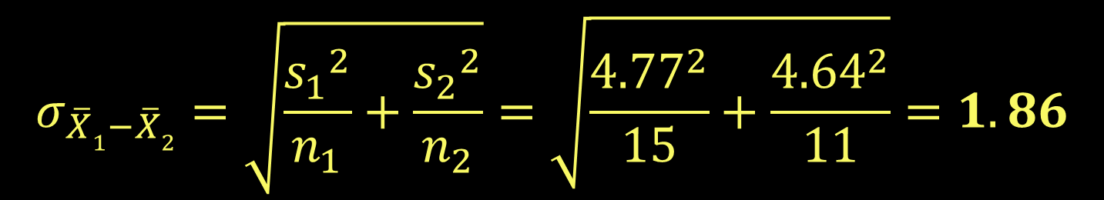
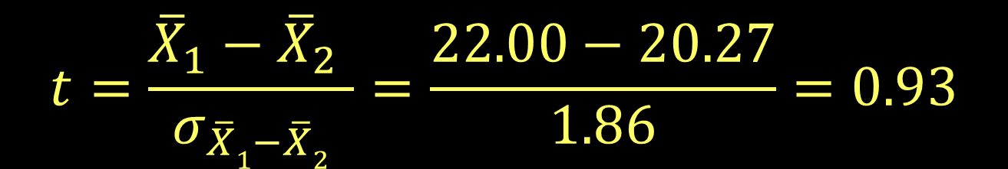
 | Sedan | Van
Number of cars | 15 | 11
Mean mpg | 22.00 | 20.27
Std Dev | 4.77 | 4.64
$$σ_{\overline{X}1−\overline{X}2}=\sqrt{\frac{{s_{1}}^{2}}{n_{1}}+\frac{{s_{2}}^{2}}{n_{2}}}=\sqrt{\frac{{4.77}^{2}}{15}+\frac{{4.64}^{2}}{11}}=1.86$$
$$t=\frac{{\overline{X}}_{1}−{\overline{X}}_{2} }{σ_{\overline{X}1−\overline{X}2}}=\frac{22.00−20.27}{1.86}=0.93$$

